Slide 1

INTRODUCTION
INTERACTIVE TRAFFIC ACCIDENT SEVERITY DASHBOARD

Slide 2
BUSINESS REQUIREMENT
Objective
Data Walkthrough & Quality Check in Excel
Data Connection using ETL Process
Data cleansing, sorting, filtering and analyzing data in SQL
Writing Queries in MS SQL Server
Data Modelling and Processing
LOD Calculations in Tableau
Dashboard Lay outing
Insights Generation
Dashboard

Slide 3
OBJECTIVE
To provide an advanced analytical representation of road accident trends and patterns, enabling stakeholders to evaluate critical metrics such as accident severity, casualty rates, and contributing factors like weather conditions, road surfaces, and vehicle types.
To facilitate data-driven decision-making by visualizing year-over-year comparisons, geographic hotspots, and causal relationships, thereby supporting effective policy implementation and safety interventions.

Slide 4
KPI REQUIREMENTS
Total Accidents :
Objective - Represents the total number of road accidents that occurred in the selected year.
Graph Type - Line chart showing monthly trends.
Total Casualties :
Objective - Indicates the total number of individuals injured or killed in road accidents during the selected year.
Graph Type - Line chart showing monthly trends.
Fatal Casualties :
Objective - Shows the total number of fatalities resulting from road accidents.
Graph Type - Line chart showing monthly trends.
Serious Casualties :
Objective - Represents the number of individuals seriously injured in road accidents.
Graph Type - Line chart showing monthly trends.
Slight Casualties :
Objective - Indicates the number of individuals with minor injuries caused by road accidents.
Graph Type - Line chart showing monthly trends.

Slide 5
CHART REQUIREMENTS
Fatal Casualties by Vehicle Type :
Objective - Breaks down fatalities by type of vehicle involved, such as cars, trucks, bicycles, and buses.
Graph Type - Icons with numerical data and percentage changes
Fatal Casualties by Weather Conditions :
Objective - Shows how different weather conditions (e.g., fine, rain, snow/fog) contribute to fatal accidents.
Graph Type - Pie chart
Fatal Casualties by Road Surface :
Objective - Highlights the impact of road surface conditions (e.g., dry, wet, frost/snow) on fatal accidents.
Graph Type - Pie chart.
Fatal Casualties by Road Type :
Objective - Categorizes fatalities based on the type of road (e.g., single carriageway, dual carriageway, slip road).
Graph Type: Bar chart
Fatal Casualties by Location :
Displays the geographical distribution of fatal accidents.
Graph Type - Geospatial map with data points.

Slide 6
ANALYSIS AND FINDINGS
Year-over-Year Increase:
There is a noticeable increase in total accidents (6.76%), total casualties (7.31%), and fatal casualties (21.67%) compared to the previous year.
Casualty Severity:
Serious casualties account for a significant proportion (36,096 cases), while slight casualties make up the largest share (206,333 cases).
Vehicle Type Contribution:
Cars contributed the highest number of fatal casualties (3,973), followed by vans (539) and bicycles (468), with a significant 46.25% increase in bicycle-related fatalities.
Weather Influence:
Most fatal casualties occurred under fine weather conditions (82%), with rain contributing to 13.38% and snow/fog being the least significant at 2.19%.

Slide 7
ANALYSIS AND FINDINGS
Road Surface Conditions:
Dry road surfaces accounted for 64.55% of fatalities, while wet surfaces were involved in 34.27%, indicating weather-related risks.
High-Risk Road Types:
Single carriageways have the highest fatality count (3,953), significantly surpassing dual carriageways (1,195) and other road types.
Geographic Hotspots:
The map visualization highlights concentrated accident hotspots in specific regions, necessitating targeted safety interventions in those areas.
Decreasing Trends in Certain Categories:
Fatalities involving pedestrians (e.g., 26.83% reduction in fatalities for certain vehicle types like buses) show promising signs of improvement.

Slide 8
RECOMMENDATIONS
Enhance Vaccination Coverage:
Bridge the gap between first and second dose administrations by launching targeted campaigns and improving accessibility, especially in rural areas.
Strengthen Testing Infrastructure:
Increase the number of testing labs in states with low capacity, such as Uttar Pradesh and Delhi, to ensure early detection and containment.
Focus on High-Risk Age Groups:
Implement preventive measures and awareness programs for the 20–29 and 30–39 age groups, as they represent the highest proportion of cases.
Gender-Specific Interventions:
Investigate the causes behind the higher proportion of male cases and design gender-specific safety guidelines to address the disparity.

Slide 9
RECOMMENDATIONS
Expand Resource Allocation to Worst-Affected States:
Prioritize healthcare resources, vaccination drives, and testing facilities in heavily impacted states like Maharashtra and Tamil Nadu.
Promote Lesser-Used Vaccines:
Increase awareness and supply of vaccines like Covaxin and Sputnik V to ensure diverse vaccine coverage and reduce dependency on CoviShield.
Leverage Data for Proactive Policies:
Use the insights on state-wise deaths, testing, and vaccination to develop region-specific strategies for managing future pandemics.

Slide 10
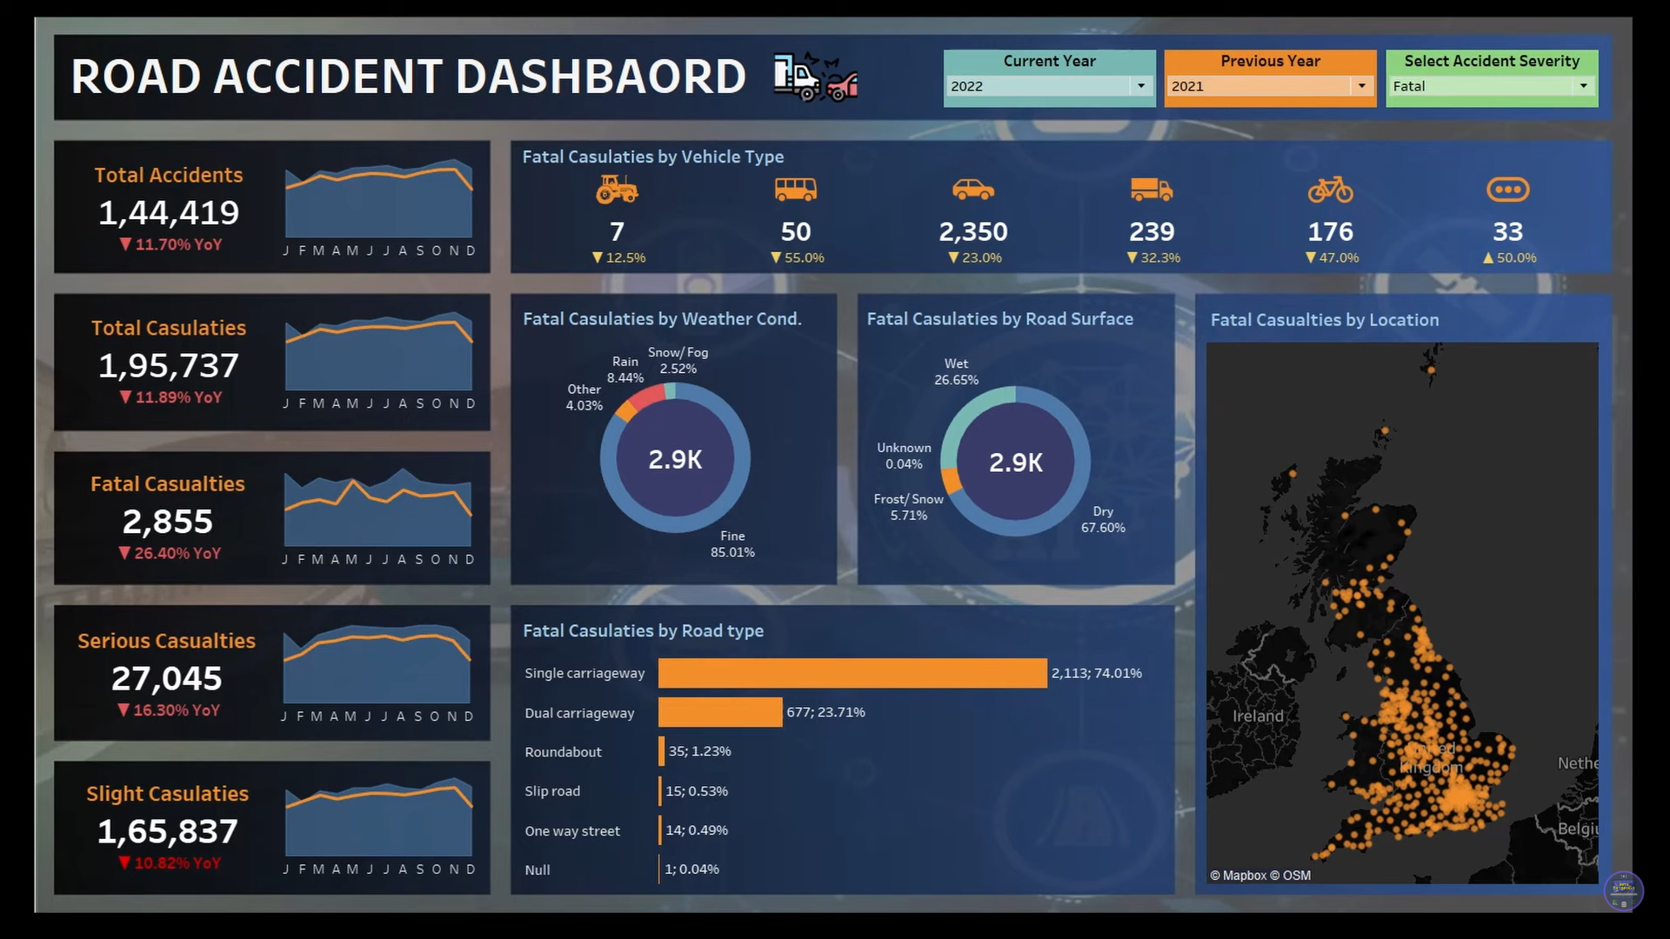
DASHBOARD

Slide 11
THANK YOU

